Slide 1
Mini Capstone Project
Gen AI for DE
Sigma DataTech Day 12

Slide 2
Day 12 —Sigma Intelligence Platform
A ₹4.72L silent disaster. Pipeline green. Dashboard wrong.
80,000 records missing. No alert fired. No one noticed for 7 hours.
Today you build the system that fixes it — in 26 seconds. Autonomously.

Slide 3

Day 12 —Sigma Intelligence Platform
WHAT YOU BUILD
Kinesis → Firehose
S3 → Snowflake
Lambda (9 tools)
CloudWatch + SNS
EventBridge trigger
THE AI LAYER
7 Bedrock Agents
MCP Server (tool discovery)
Knowledge Base — RAG
Guardrails (PII + compliance)
Amazon Nova Pro
AGENTS
Forensics → Impact → Recovery → Rollback → Hardening → Report

Slide 4
Day 12 —Sigma Intelligence Platform
The same architecture runs at PhonePe, Razorpay & CRED.
You will build it, break it, and watch AI heal it.

Slide 5
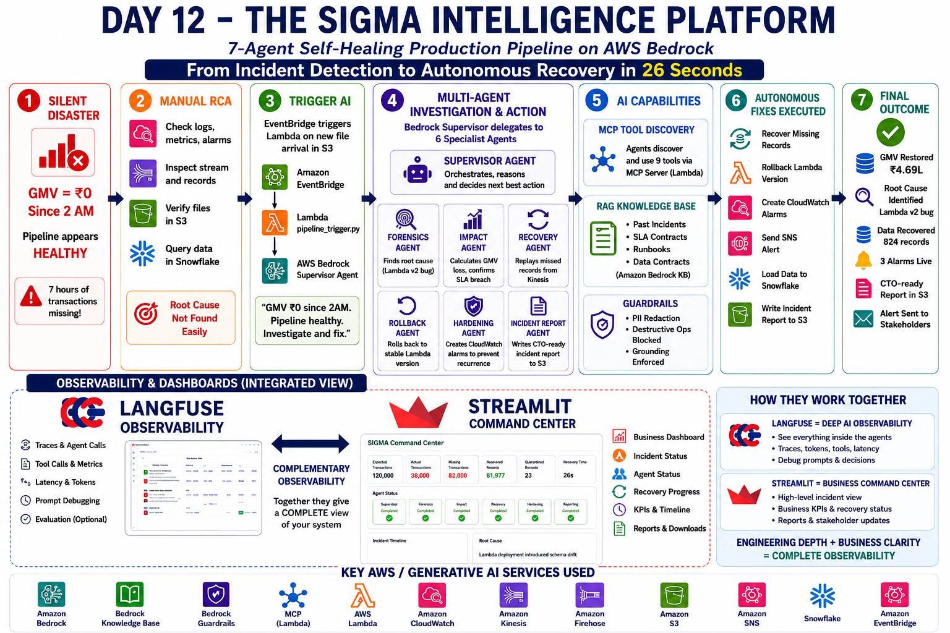

Slide 6
Two Modes to implement
Speed Runner Mode
README.md only
No hints. No steps.
Do it yourselves
2X Points
Guided Quest Mode
Implementation Guide
Every step. Every command.
Normal Points
Stretch : Implement Streamlit dashboard to gain Bonus Points

